Slide 2
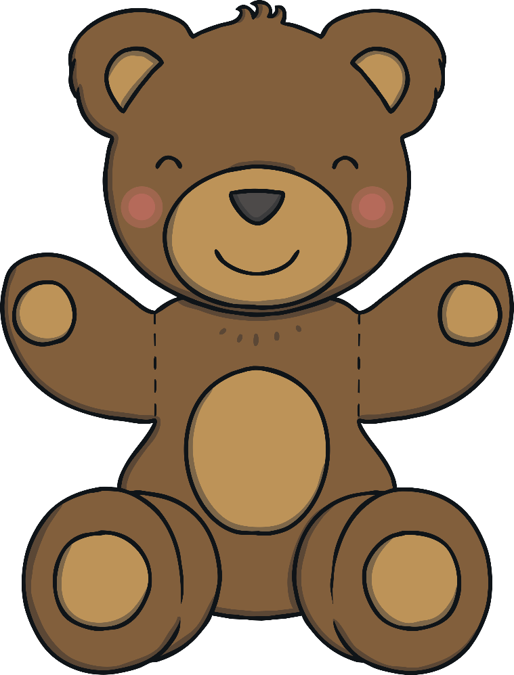
Instructions
I love living in the toy shop – there are so many different toys!
Can you help me compare the sets of toys?
Which sets have more?
Which sets have fewer?
Click on the sets of pictures to check your answers.
Remember to listen to the question carefully.
Start

Slide 3
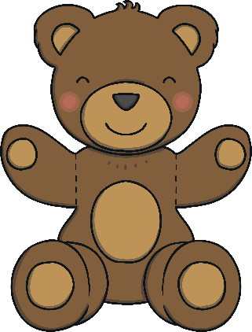
Which set contains more toys?
back
next
Correct! There are more building bricks than dolls.
Try again.

Slide 4
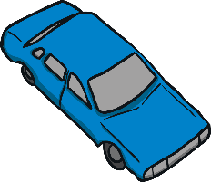
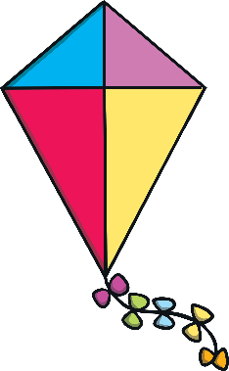
Which set contains more toys?
back
next
Correct! There are more cars than kites.
Try again.

Slide 5
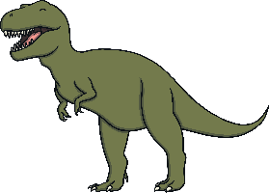
Which set contains more toys?
back
next
Correct! There are more dinosaurs than books.
Try again.

Slide 6
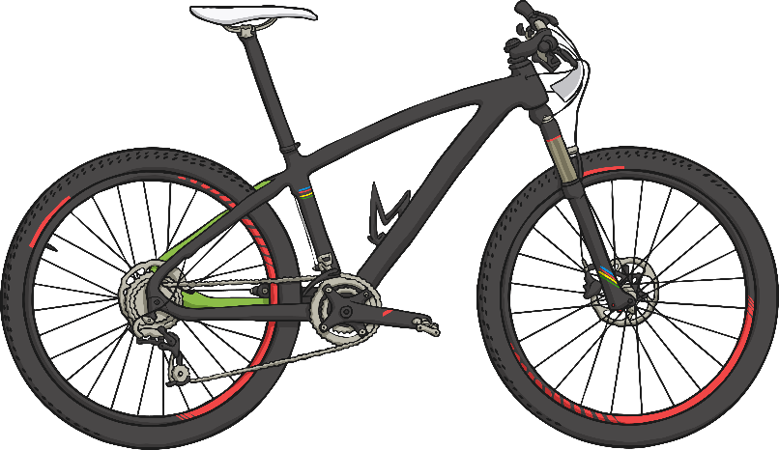
Which set contains more toys?
back
next
Correct! There are more puppets than bikes.
Try again.

Slide 7
Which set contains fewer toys?
back
next
Correct! There are fewer yo-yos than marbles.
Try again.

Slide 8
Which set contains fewer toys?
back
next
Correct! There are fewer skipping ropes than robots.
Try again.

Slide 9
Which set contains fewer toys?
back
next
Correct! There are fewer boats than paintbrushes.
Try again.

Slide 10
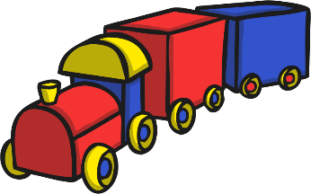
Which set contains fewer toys?
back
next
Correct! There are fewer trains than action figures.
Try again.

Slide 11
The End
Well done – super comparing!
Play again

