Slide 1
PSHE and Citizenship
Relationships | Growing Up
PSHE and Citizenship | Year 6 | Relationships | Growing Up | Just the Way You Are | Lesson 3

Slide 2
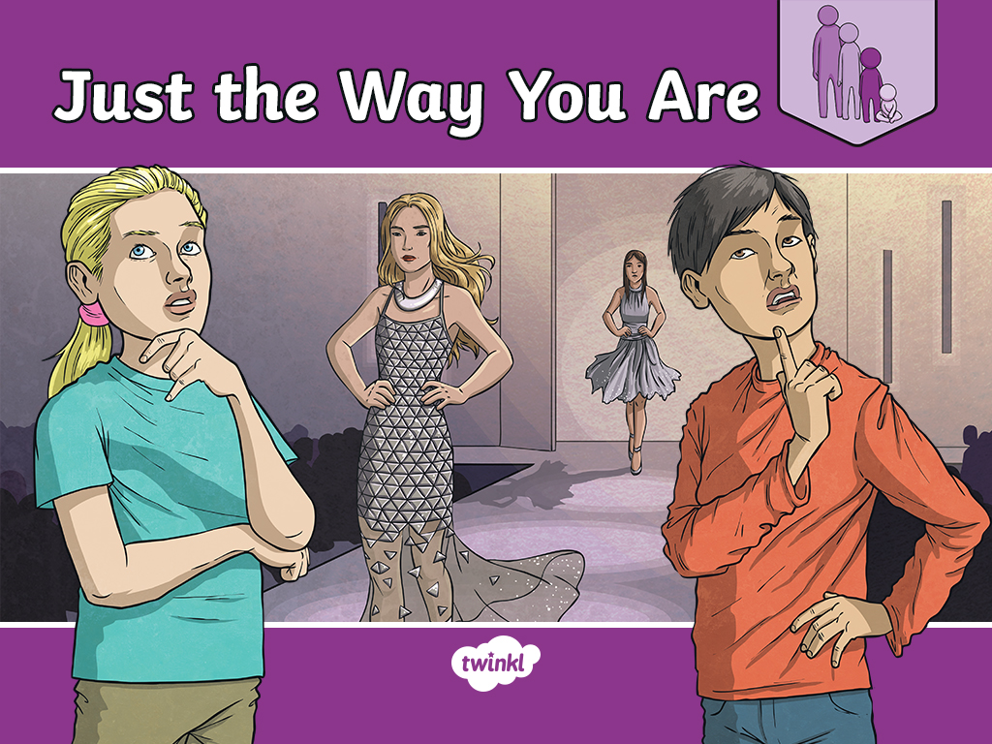

Slide 3
Aim
I recognise that many things affect the way we feel about ourselves and I understand that there is no such thing as an ideal body.
Success Criteria
I understand the term ‘body image’.
I can name some things that affect the way we see ourselves.
I appreciate that people have different bodies and can look very different from one another.
I understand that images we see on social media can be misleading.
This resource is fully in line with the Learning Outcomes and Core Themes outlined in the PSHE Association’s Programme of Study.

Slide 4
The Big Questions

Slide 5

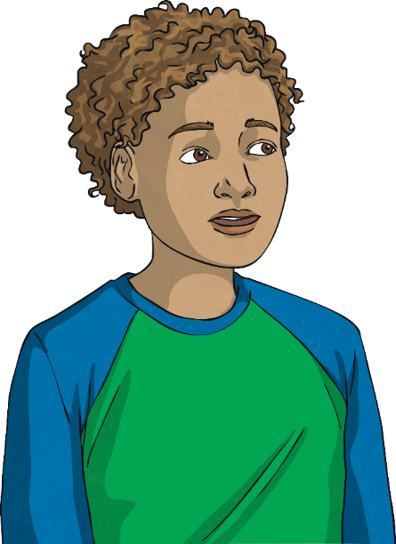
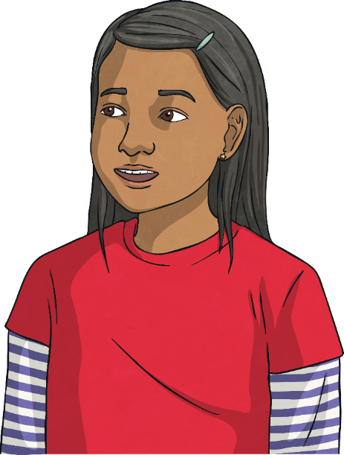
The Big Questions
Is there an ideal kind of body?
What information can affect how we think and feel about ourselves and our bodies?

Slide 6
Reconnecting

Slide 7


Every Body!
‘Good For Her’ by Tony Alter. ‘Sumo wrestler in Japan’ by Nakatani YOshifumiis are licensed under CC BY 2.0.

Slide 8

Every Body!

Slide 9
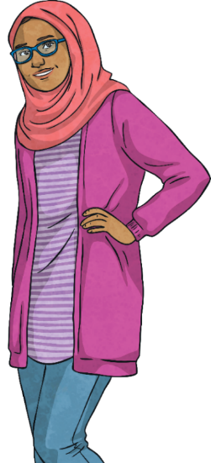
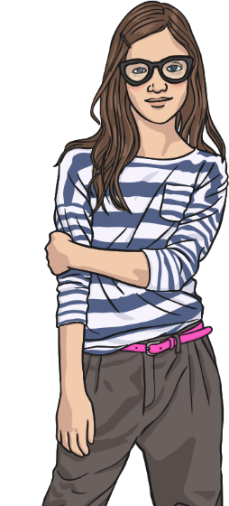
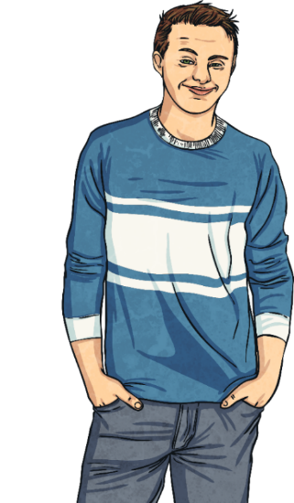
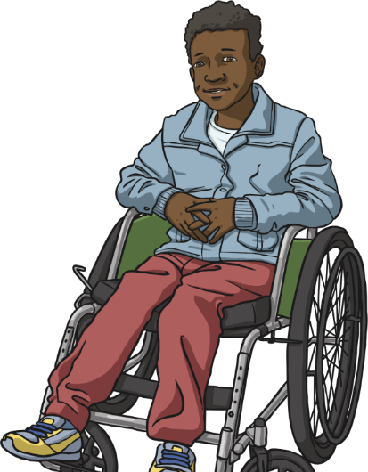
Every Body!
Look around at all the people in the world and all the different types of bodies they have. What a wonderful variety! Everybody has a unique body and it is important that we look after the body we have, as best we can.
Talk to your partner about the ways in
which you can look
after your body.
Not everyone likes the body they have, and at times many people wish they could change their bodies. However, it is important that we learn to love the body we have and be aware of the things around us that can influence the way we see ourselves.

Slide 10
Exploring

Slide 11

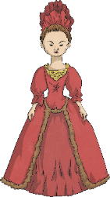

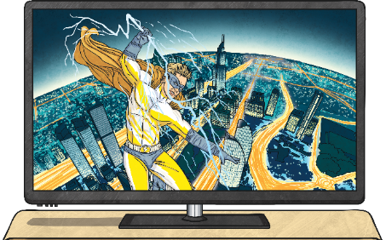
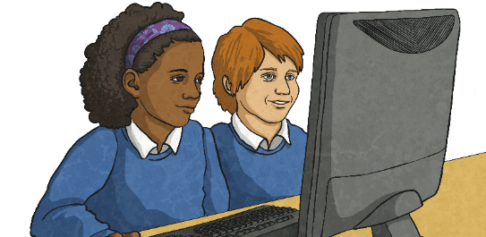
Body Image
Every day we see images of ‘ideal’ bodies.
With your partner, list some places you see images of ‘ideal’ or
‘perfect’ bodies.
adverts on the television
toys, such as dolls representing women
adverts in magazines
images we see online
music videos

Slide 12


Body Image
Compare these pictures to the ones we looked at earlier in the lesson. Do these represent all the body types we see in our society?

Slide 13
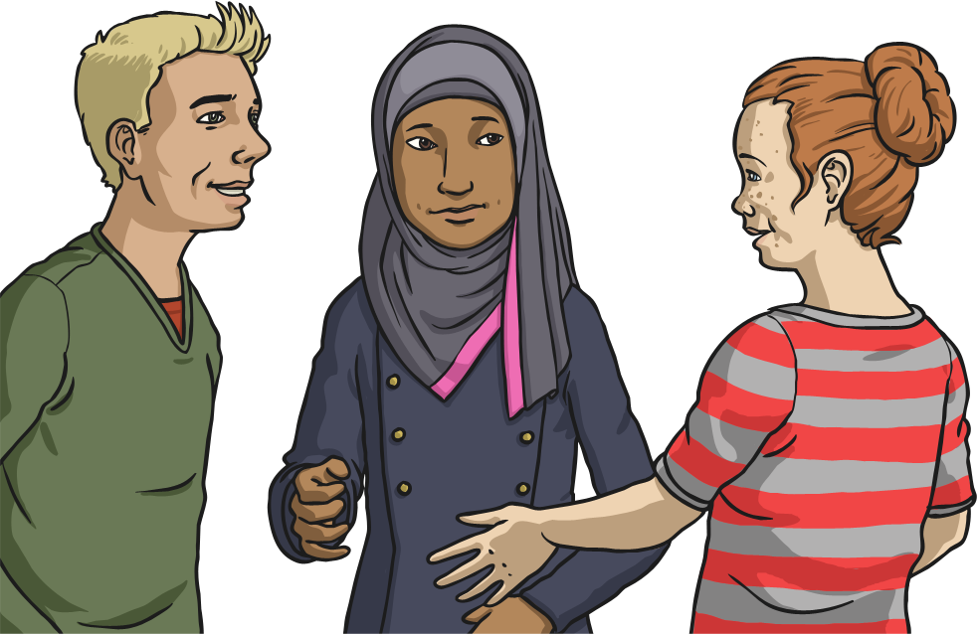
Body Image
Why do you think adverts, posters, magazines, music videos and television programmes tend to feature people with these bodies?
Do you think these images help people to have a positive body image and be happy with their own bodies?
What sort of message do you think this sends to everyone who sees
the images?
Do you think those images we see in magazines and on the television are accurate, truthful images?

Slide 14
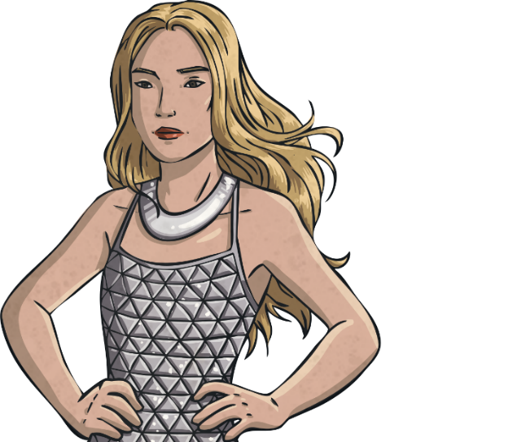
Body Image
Sometimes, people are made to look taller, thinner, or more muscly than they are in
real life.
Did you know that people in the media, film and photography industry are able to
alter images?
Technology is amazing and so advanced that images we see of people in magazines or on the screen have often been changed to make them look more how the company want them to look.
It isn’t a true reflection of the person, but sadly companies are allowed to do it.
So a make-up model who has spots on the day of the photo shoot can magically have their spots erased with computer technology before the
image is turned into an advert.

Slide 15
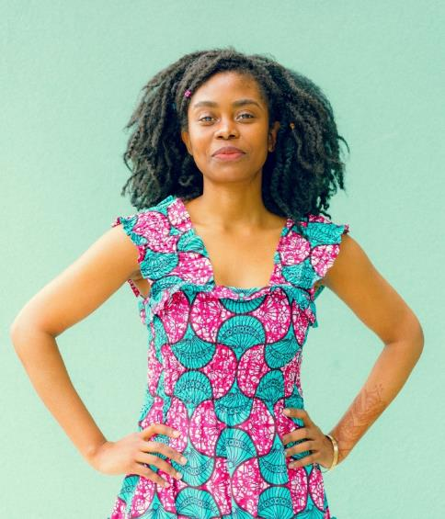
Body Image
We need to remember that a lot of images we see are not real. A photo like this might have had lots of things done to it to make the model look like this. This is
called retouching.
Look around and you will see real people in the real world. We are all different shapes and sizes, with different hair and faces. There is no ‘ideal’ way to look.

Slide 16
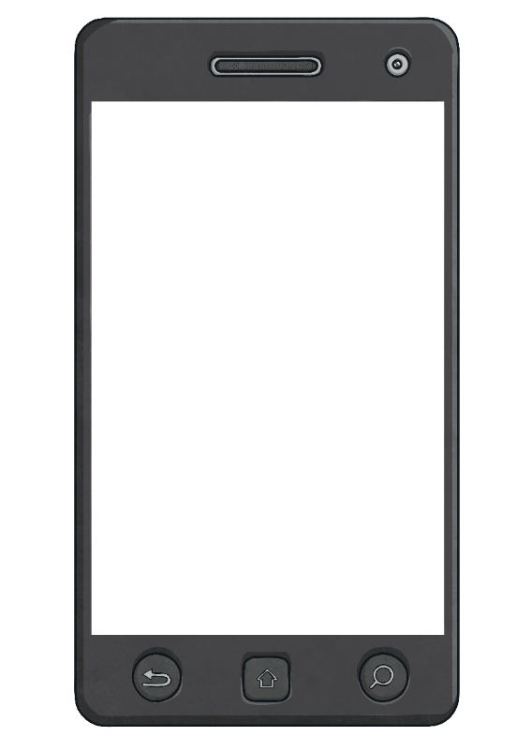
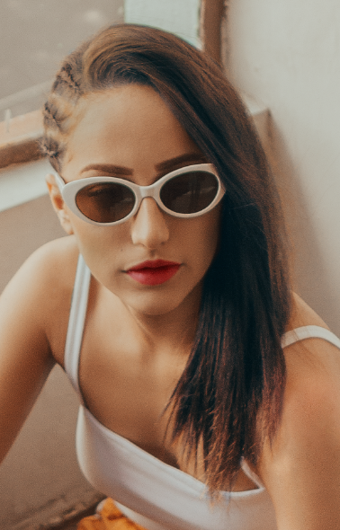
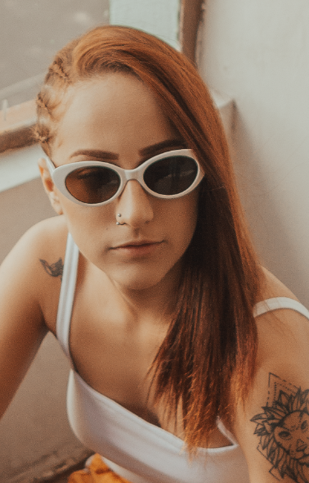
Body Image
It isn't just advertising companies that alter or photoshop images.
Modern technology means that most mobile phones have facilities to edit our own photos.
The pictures we see posted on social media sites may look like natural selfies but they have often been changed to make the person in the photo look more 'perfect'.
edit
undo

Slide 17
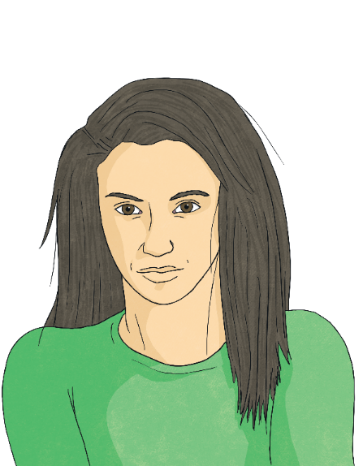
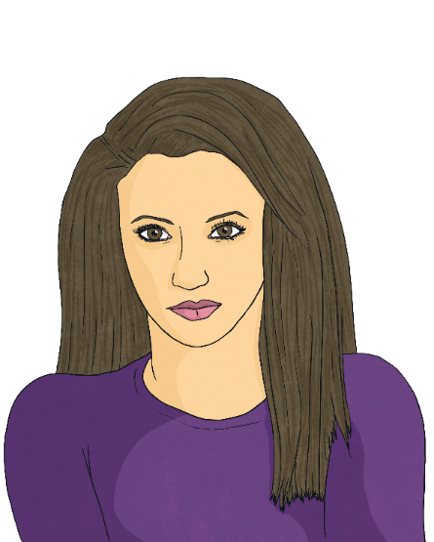
Spot the Difference!
Let’s play spot the difference!
You are going to see some images before and after they have
been retouched.
Discuss with your partner what is different between the two images and how they have been altered to look ‘better’ or ‘more attractive’.

Slide 18
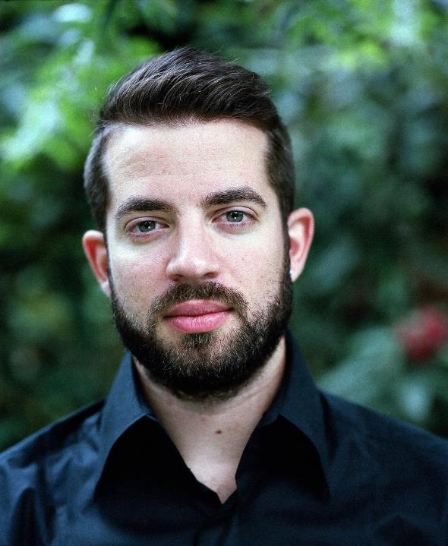
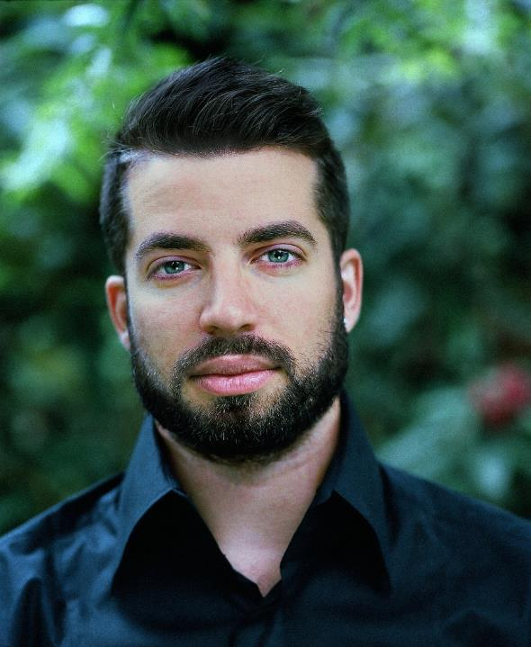
Spot the Difference!

Slide 19
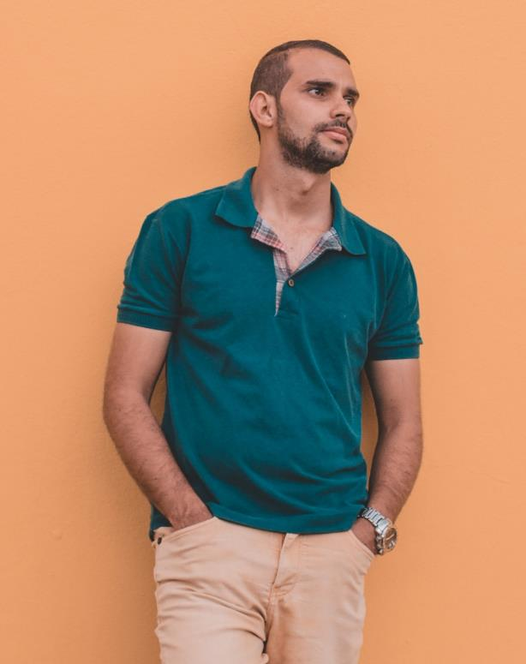
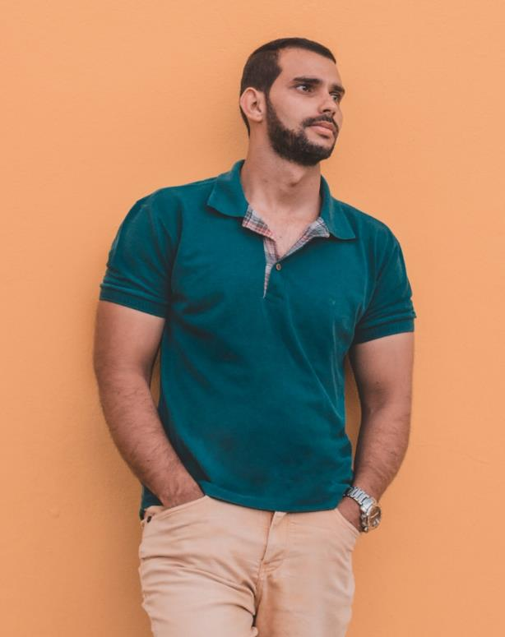
Spot the Difference!

Slide 20
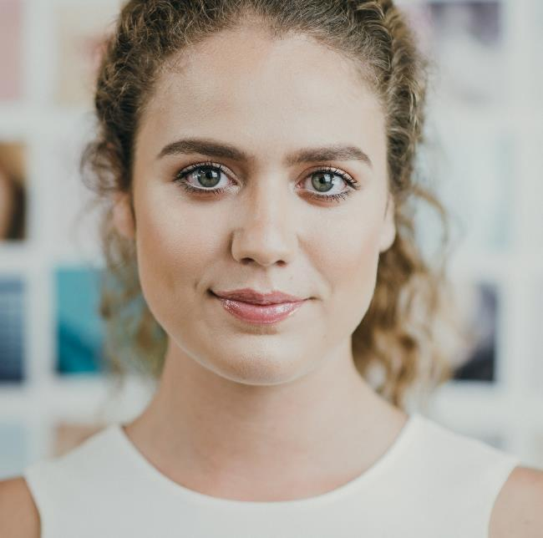
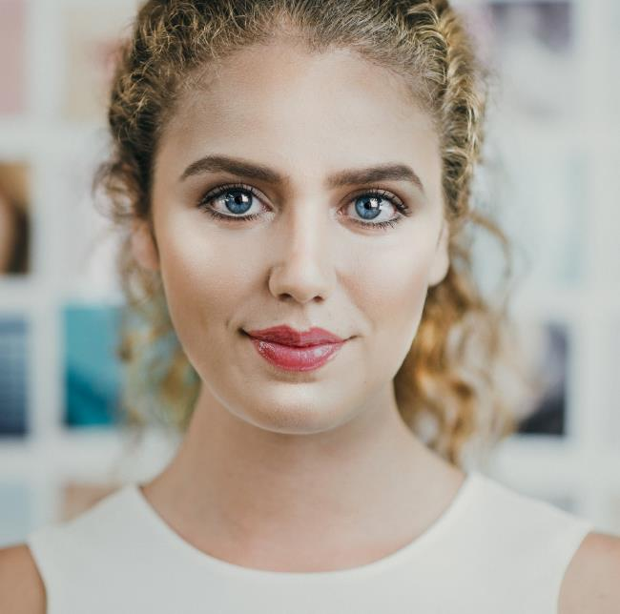
Spot the Difference!

Slide 21
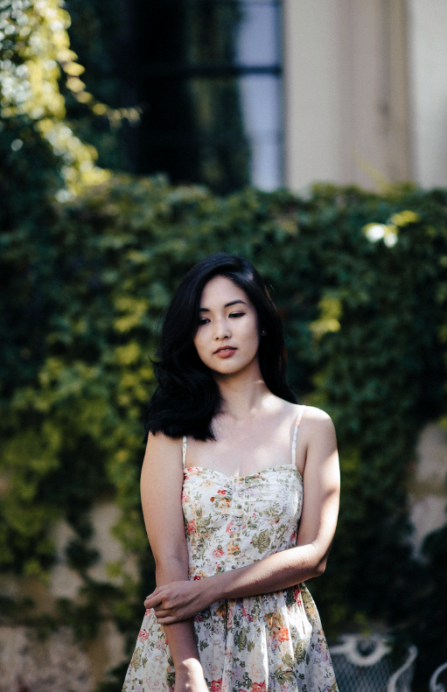
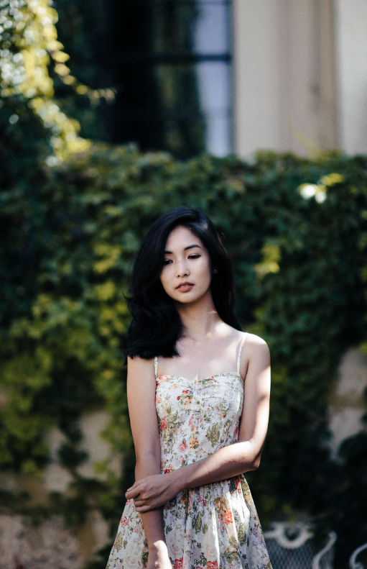
Spot the Difference!

Slide 22
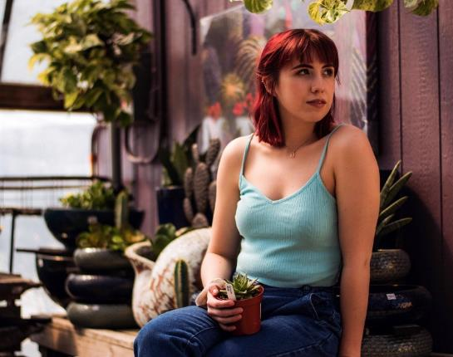
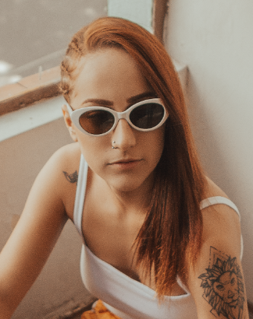
Spot the Difference!
Ad Campaigns With a Difference
Some companies are trying hard to use a range of different looks in their adverts, so that more people in society are represented. They are trying to move away from using the stereotypical ‘ideal’ body or ‘perfect’ face.

Slide 23
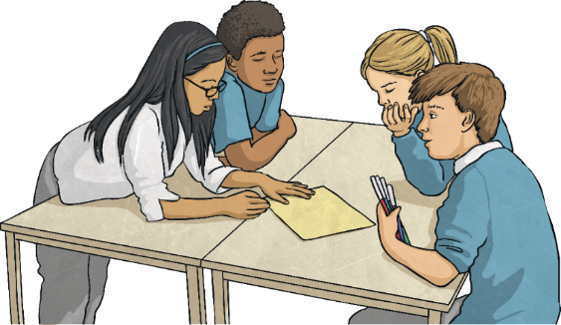
More Than Just a Body
Who you are – or your identity – is much more than just the way
you look.
Who you are is made up of your personality, the things you like doing, the skills you have, your experiences, your accomplishments and many more attributes.
We can feel good about who we are for lots of different reasons.
What might the people from the first set of images we looked at say about themselves?
What might they have achieved?
What might they be good at?
What might they enjoy doing?
What positive messages might
they have to share?

Slide 24
More Than Just a Body
‘Good For Her’ by Tony Alter. ‘Sumo wrestler in Japan’ by Nakatani YOshifumiis are licensed under CC BY 2.0.

Slide 25
More Than Just a Body

Slide 26


More Than Just a Body
So, what have we learnt?
Consolidating
Reflecting

Slide 27
Consolidating

Slide 28

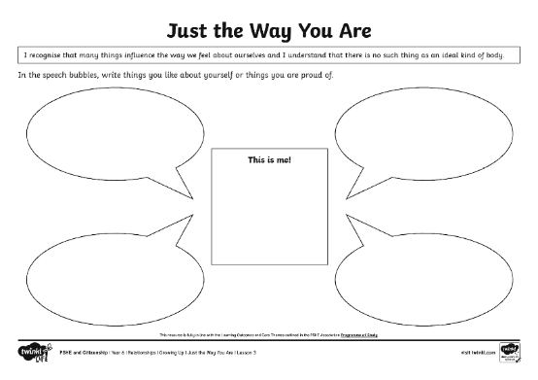
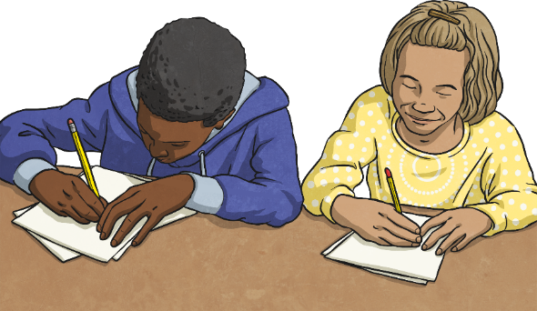
This Is Me!
How would you describe yourself?
Who are you?
What do you like doing?
What are you good at?
What are your dreams or goals for
the future?
What are you proud of?
Is the way you look the most important part of who you are?
Add comments about the person you are and what you are proud of in the speech bubbles on the activity sheet.

Slide 29
Reflecting

Slide 30
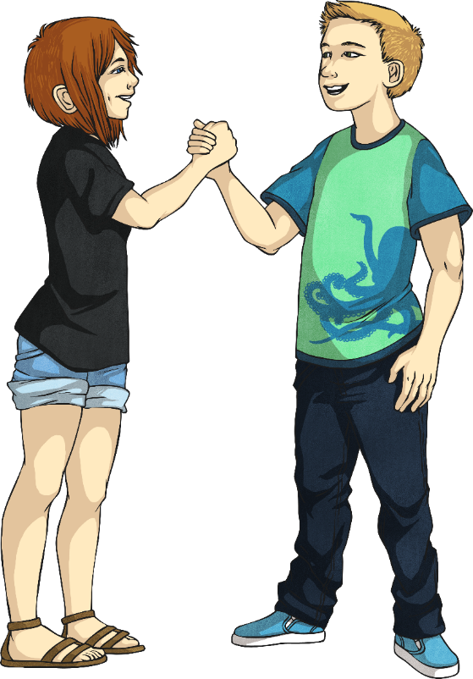
Something I Like about You
As a class, we are going to play a game, called ‘Something I Like about You’.
Think about the person sitting next to you. We are going to take turns to pay the person next to us a compliment. When it is your turn, tell the person next to you something you like about them.
Paying others compliments can help them to have a more positive body image of themselves.
Your compliment could be about their appearance, but it could be about their personality, skills, talents or achievements.

Slide 31
The Big Questions

Slide 32
The Big Questions
Is there an ideal kind of body?
What information can affect how we think and feel about ourselves and our bodies?

Slide 33
Aim
I recognise that many things affect the way we feel about ourselves and I understand that there is no such thing as an ideal body.
Success Criteria
I understand the term ‘body image’.
I can name some things that affect the way we see ourselves.
I appreciate that people have different bodies and can look very different from one another.

