Slide 1

PSHE and Citizenship
Relationships | Growing Up
PSHE and Citizenship | Year 6 | Relationships | Growing Up | Relationships | Lesson 4

Slide 3
Aim
I understand what a loving relationship is and that there are many types of relationships.
Success Criteria
I understand the terms associated with love, relationships and
sexual orientation.
I appreciate that people differ in terms of sexual orientation and who they love.
I can describe what makes a loving relationship.
This resource is fully in line with the Learning Outcomes and Core Themes outlined in the PSHE Association.

Slide 4
The Big Questions

Slide 5

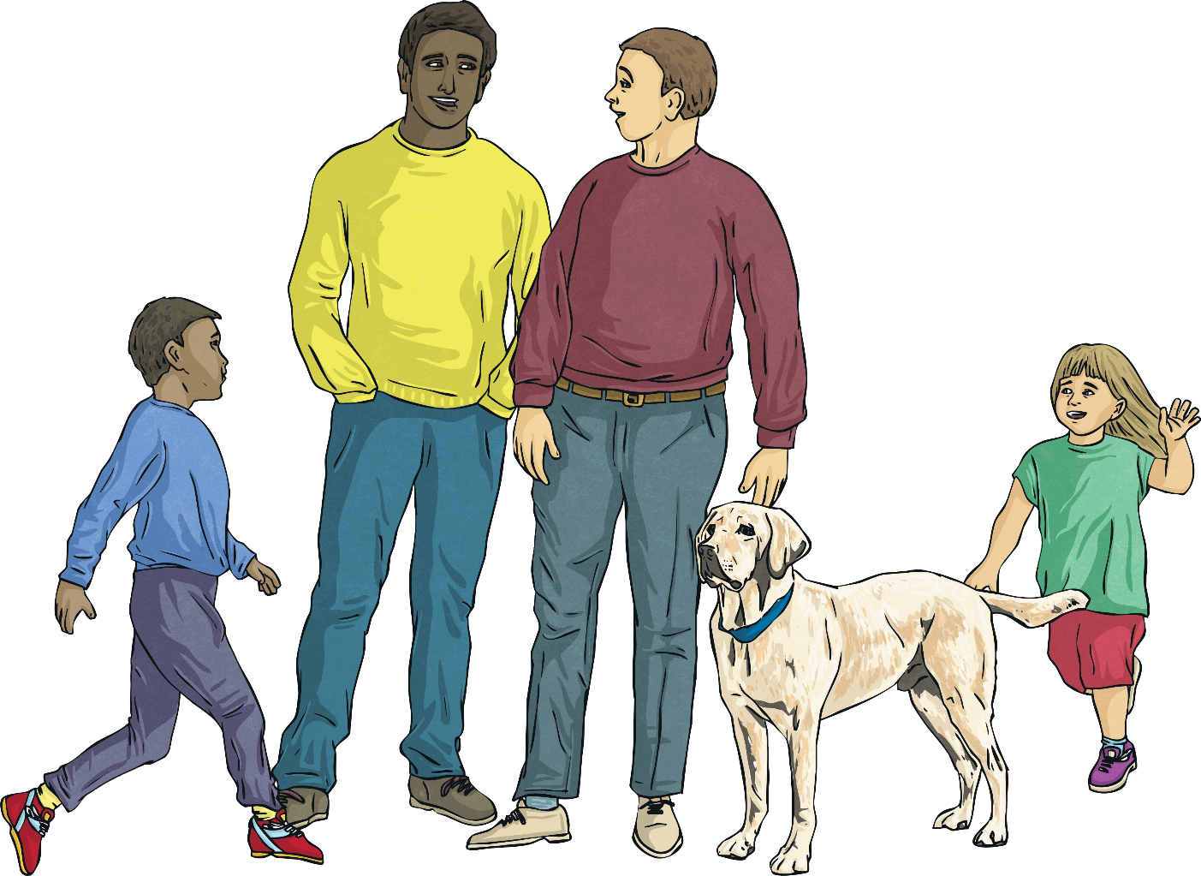
The Big Questions
What is a loving relationship?
What kinds of loving relationships are there?

Slide 6
Reconnecting

Slide 7


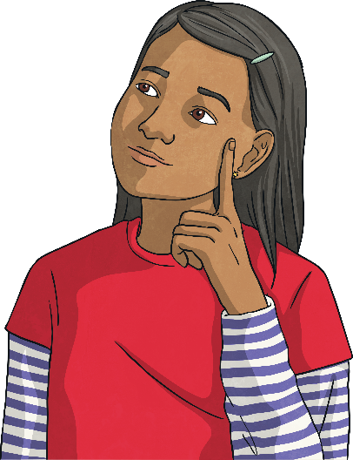

Reconnecting
What words and phrases spring to mind when you think about these
big questions?
What do you think of when you think of the term ‘loving relationship’?
What different types of relationships can you think of?
With your talk partner, create a mind map or chart of ideas, jotting down any words and phrases you think might be useful for today’s lesson. It is OK to use any vocabulary you know relating
to relationships.

Slide 8


Relationships
Useful vocabulary for today’s lesson…
lesbian
gay
same-sex
adopted
race
age
religion
homosexual
heterosexual
parent
siblings
disabled
love

Slide 9
Exploring

Slide 10

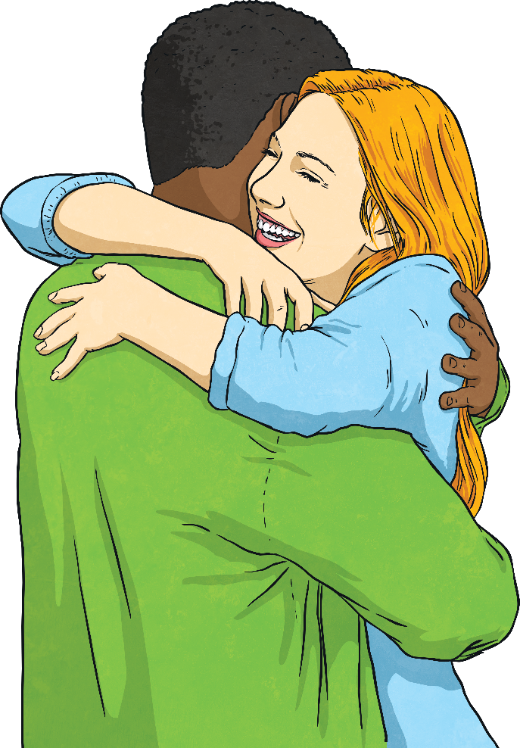
Loving Relationships
We are going to start the lesson by watching a video.
It is called ‘Love Has No Labels’. What do you think that
could mean?
Whilst watching, think about the different types of relationships featured in the video.
You might like to try using some of the vocabulary we have just looked at to
describe some of the relationships you see.

Slide 11


Love Has No Labels
Please check the content in this link, including any comments, is suitable for your educational environment before showing. Please do not let the next video automatically play at the end of the clip. Twinkl accepts no responsibility for the content of third party websites.

Slide 12
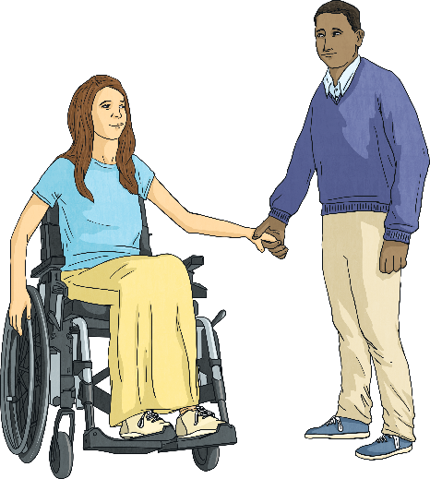
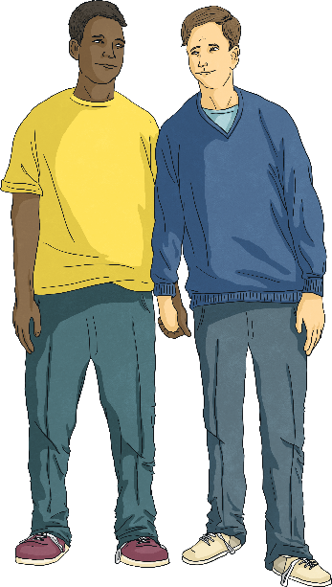
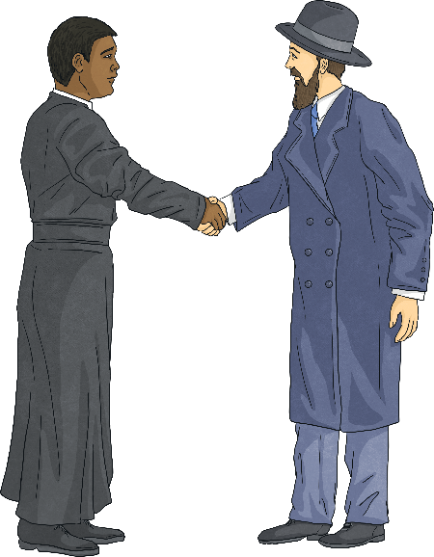
Loving Relationships
What did you think of the video?
Talk to your partner about the different types of relationships you observed and make a list together.
Were there any relationships that surprised you?
How did the crowd react to the different types of relationships?
Would you have reacted the same way, if you had been there?

Slide 13
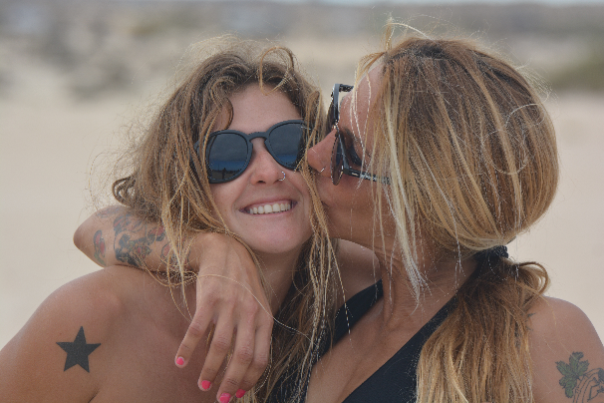
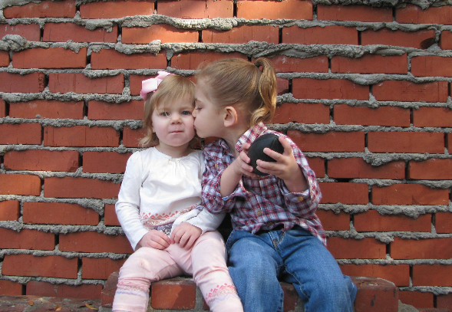
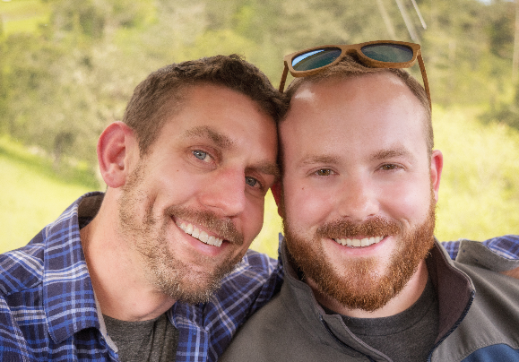
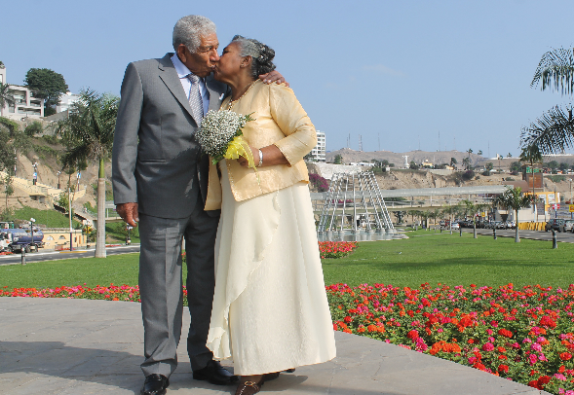
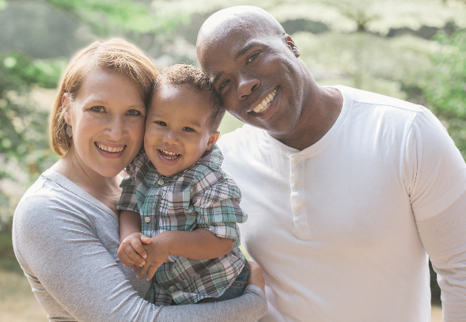
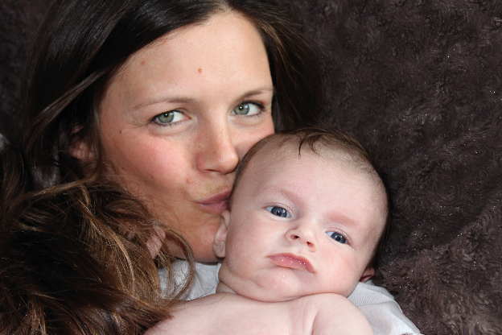
Loving Relationships
These girls love
each other.
This girl loves
her friend.
These men are in a loving relationship.
This elderly couple are in love.
This couple love each other and their child.
This mother loves
her baby.
Photo by David Goehring is licensed under CC BY 2.0.

Slide 14
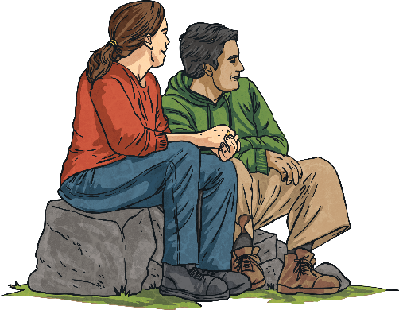
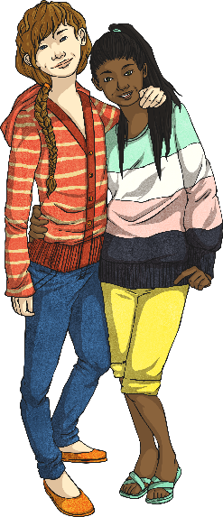
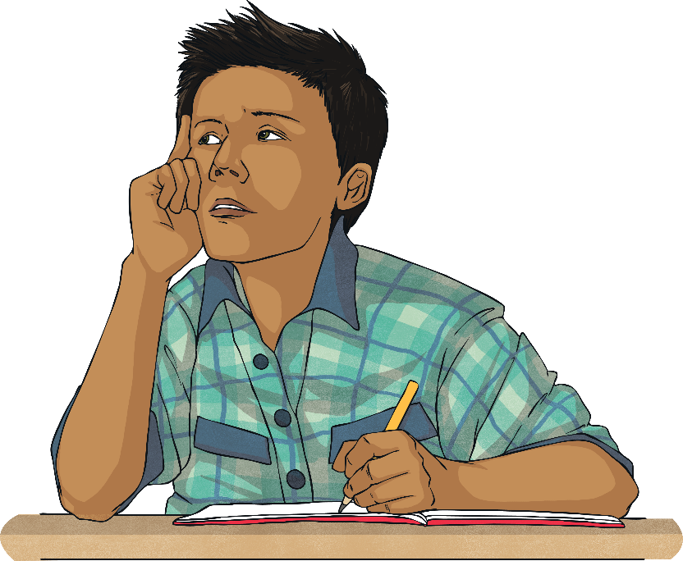
Loving Relationships
A loving relationship can be between friends, members of a family
or couples.
There are many types of loving relationships. We have different sorts of relationships with different people in our lives, at different times.
Whilst loving relationships may involve different combinations of people, they will all have some things in common.
With your talk partner, list things that you think a loving relationship has
or needs.

Slide 15

Loving Relationships
Elements of a loving relationship – no matter who is in the relationship…
advice
commitment
honesty
care
affection
loyalty
trust
communication
kindness
fairness
shared interests
consideration
help
time
respect
common goals
support

Slide 16
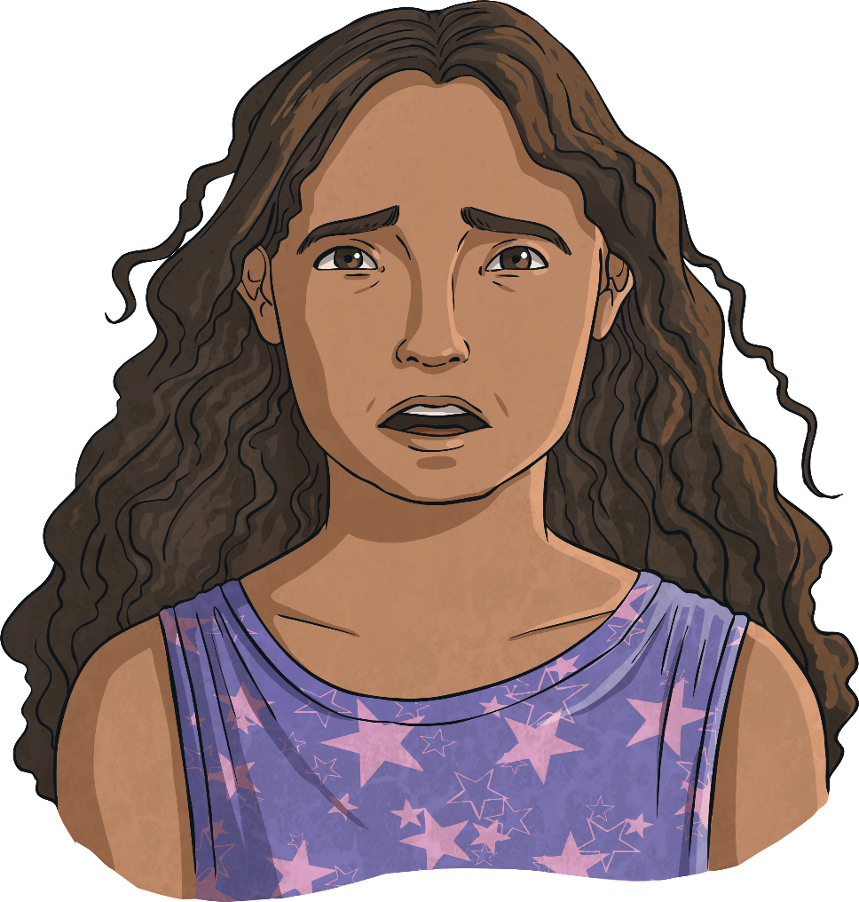
Loving Relationships
A loving relationship between two people is mutual and consensual.
This means that both people in the relationship want to be in
the relationship.
Forcing someone to marry is a crime. Unfortunately, this does sometimes happen, but there is support available to prevent and protect people from being forced into marriage.

Slide 17

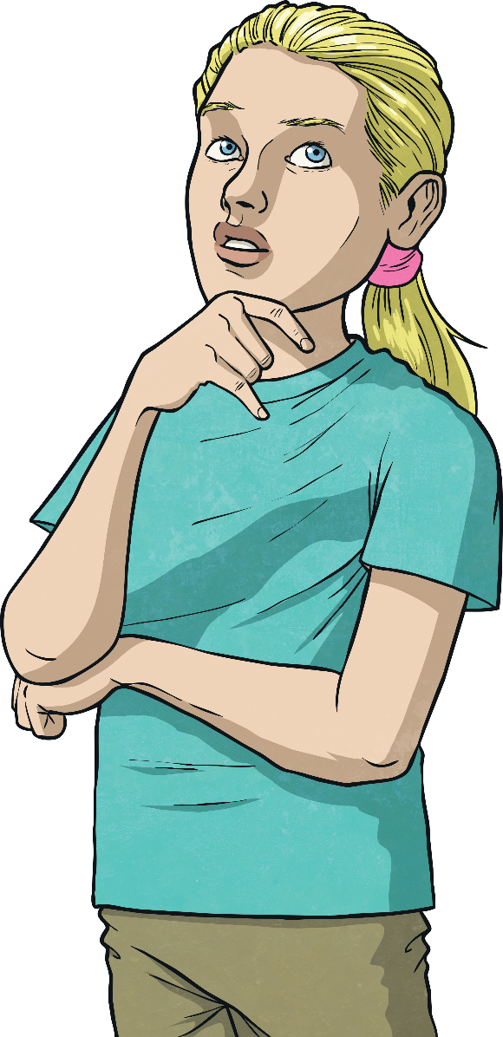
Loving Relationships
So, what have we learnt?
Consolidating
Reflecting

Slide 18
Consolidating

Slide 19

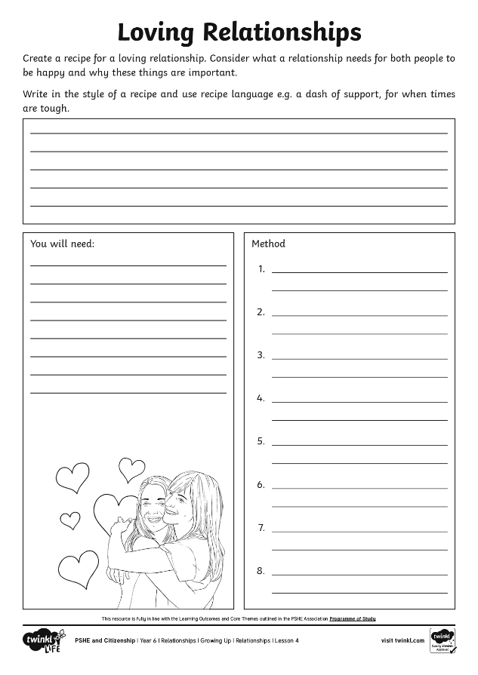
Recipe for a
Loving Relationship
Create a recipe for a ‘loving relationship’.
Use phrases that we associate with recipes, such as:
a dash of…
a sprinkle of…
plenty of…
lots of…
stir in some…
pour in…
Can you add a note about what should definitely not be added to the recipe?

Slide 20
Reflecting

Slide 21
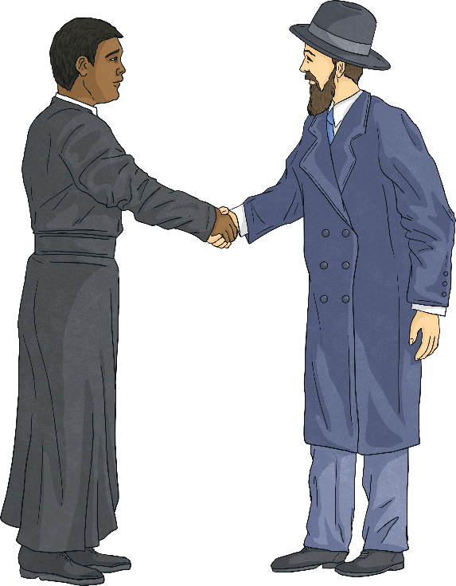
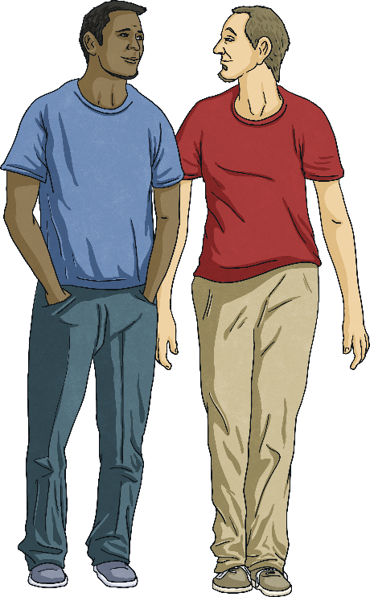
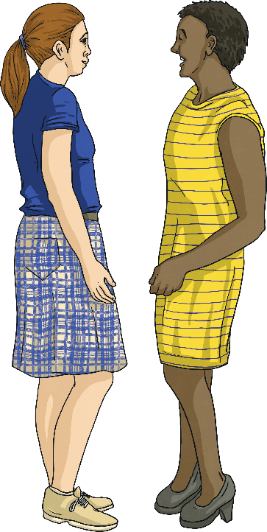
Loving Relationships
Reflect quietly on the following questions…
What do all the loving relationships we have seen today in the video and images have in common?
Why would people want to be in a loving relationship?

Slide 22
The Big Questions

Slide 23
The Big Questions
What is a loving relationship?
What kinds of loving relationships are there?

Slide 24
Aim
I understand what a loving relationship is and that there are many types of relationships.
Success Criteria
I understand the terms associated with love, relationships and
sexual orientation.
I appreciate that people differ in terms of sexual orientation and who they love.
I can describe what makes a loving relationship.

