Slide 1

PSHE and Citizenship
Relationships | Growing Up
PSHE and Citizenship | Year 6 | Relationships | Growing Up | Let’s Talk about Sex | Lesson 5

Slide 2
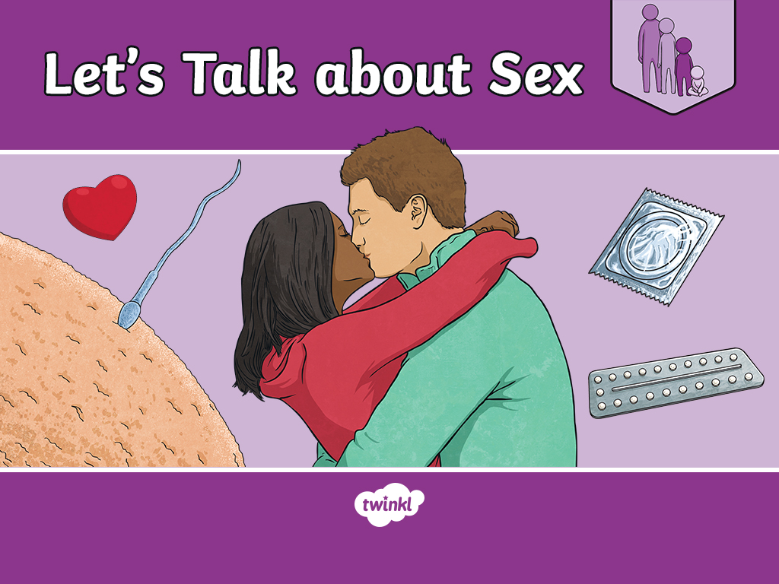

Slide 3
Aim
I understand what a sexual relationship is and who can have a
sexual relationship.
Success Criteria
I can describe the terms ‘sexual relationship’ and ‘sexual intercourse’.
I can explain who can have a sexual relationship, according to
the law.
I can explain what an STI is and I know how these can be prevented.
I can judge when physical contact is unacceptable and I know how
to respond.
This resource is fully in line with the Learning Outcomes and Core Themes outlined in the PSHE Association.

Slide 4
The Big Questions

Slide 5



The Big Questions
What is a sexual relationship and who can have one?
What is an STI and how can they be prevented?
What type of physical contact is unacceptable and how should we respond?

Slide 6
Reconnecting

Slide 7

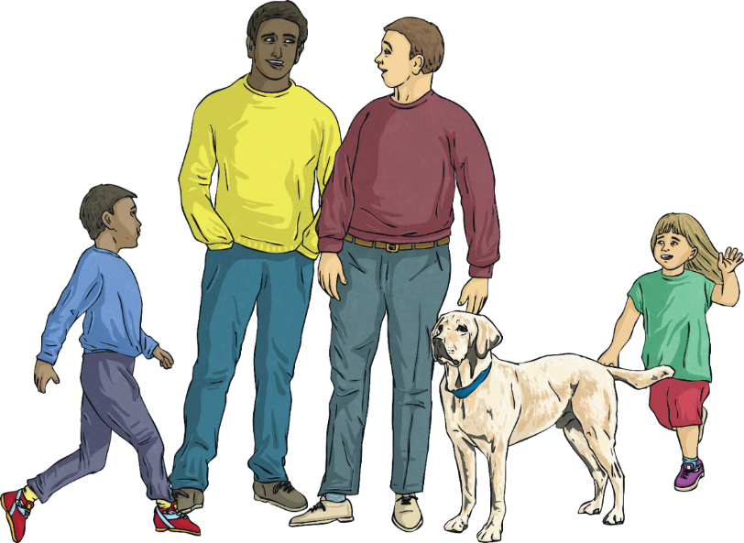
Relationships
Write down any questions you may have about sex, on a sticky note.
Think back to the last lesson, which was all about different relationships.
What different kinds of relationships can you remember?

Slide 8
Exploring

Slide 9


Let’s Talk about Sex
What is ‘Sex’?
We may hear the word ‘sex’, ‘sexy’ and ‘sexual’, especially in modern pop songs or in films, but what does it actually mean?
The term ‘sex’ is short for ‘sexual intercourse’.
It can also mean gender.
The dictionary definition of ‘sexual intercourse’ is:
Sexual contact between individuals involving penetration, especially the insertion of a man's erect penis into a woman's vagina.

Slide 10
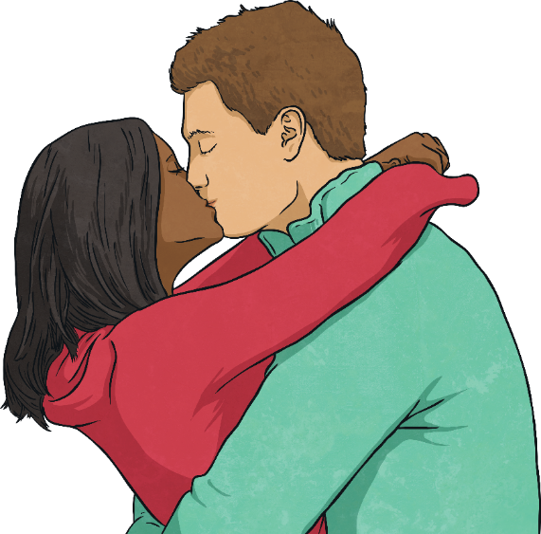
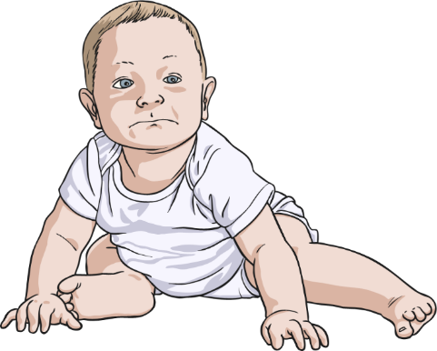
Let’s Talk about Sex
Why Do People Have Sex?
Sexual intercourse, or ‘sex’ for short, is one way that two adults in a loving relationship may show their love for one another.
It is also the start of the reproduction process, when a couple want to make a baby.

Slide 11
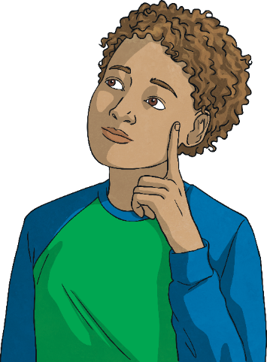
Let’s Talk about Sex
Sex and the Law
The legal age that people can have sex in the UK is 16 years old.
Both people in the sexual relationship must be 16 years old or over.
Both people must consent (want to have sexual intercourse). If one person forces another person to have sex, it is called rape. Rape is against the law.
In most modern societies, it is illegal for two people closely related to each other to have a sexual relationship, such as having sex with a parent, child, brother, sister, or grandparent. This crime is called incest.
Why do you think these laws exist?

Slide 12

Let’s Talk about Sex
Media, such as pop songs and television programmes, would have us believe that everyone is having sex and that being ‘sexy’ is
really important!
In reality, this is not the case. Two people who find each other sexually attractive, who are 16 years old or more, may decide to have a sexual relationship, if they care for one another very much and love each other.
As you go through puberty and your body and emotions change, you may start to feel sexually attracted to others. Having a ‘crush’ or ‘fancying’ someone is normal. It might be someone you think is good looking, or who you admire. It might be someone you know, or someone you have never met (like a celebrity). It doesn’t mean you love them and it doesn’t mean you want to have sex with them.

Slide 13
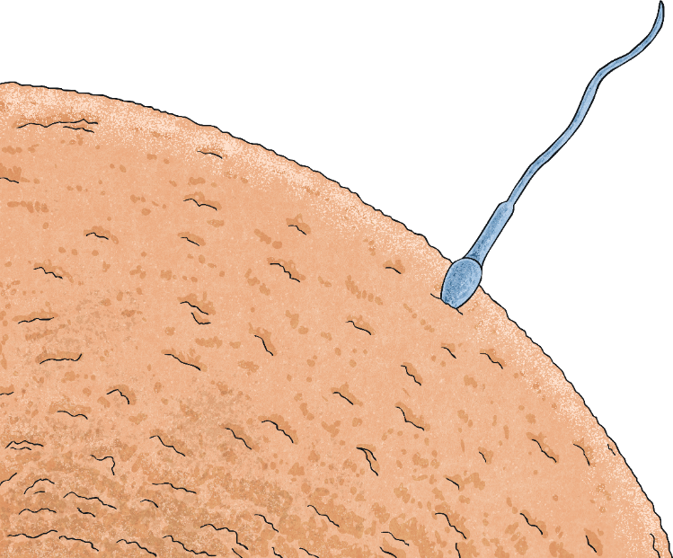
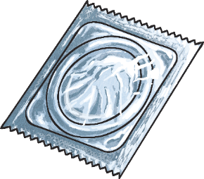


Let’s Talk about Sex
Sexual intercourse is also necessary for reproduction (in other animals as well as humans). It is how the sperm meets the egg, as you might remember from other lessons.
Although sexual intercourse doesn’t always mean that a baby will be conceived (made), it might. If a couple want to have sex, but do not want to make a baby, they can use contraception to stop the woman becoming pregnant.
Contraception methods include condoms, which the man wears on his penis to catch the sperm, or a pill that a woman takes to prevent her ovaries from releasing an egg. If there is no egg to be fertilised, the woman can’t get pregnant.

Slide 14

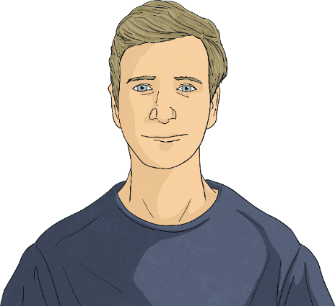

Staying Safe and Healthy
Just as we can share germs by sharing a drink with someone, or by sneezing near them, infections can be passed from one person to another through sexual intercourse, through bodily fluids such as sperm.
There are several sexually transmitted infections (commonly called STIs for short). Some can be very serious and make people very ill.
Using contraception such as a condom prevents an infection being passed from one person to another when they have sex. Not all forms of contraception protect against these diseases though. For example, the contraceptive pill would not protect someone from sharing an infection with their partner.

Slide 15
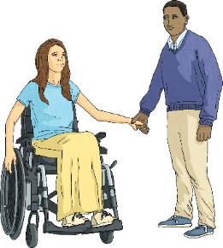
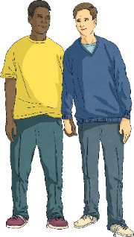

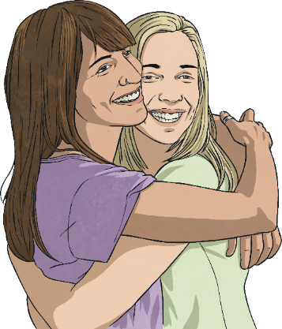
Staying Safe and Healthy
Looking after your body and protecting yourself against sexually transmitted infections (STIs) is an important part of staying safe and healthy when you
are older.
You wouldn’t know by looking at someone if they had an STI. They may not even know themselves! Knowing the other person very well and trusting them is as important as using protection, such as a condom.
Taking care and making sensible choices in a sexual relationship is called having ‘safe sex’. This includes being able to say ‘no’ to something you don’t want to do, even if you love the other person.

Slide 16
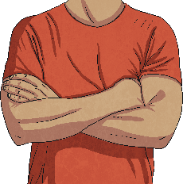
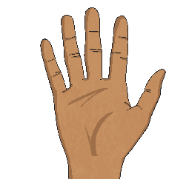
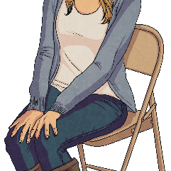
Staying Safe and Healthy
Staying safe also refers to being in charge of what happens to your body. Your body is your own and no one else can touch it without
your consent.
Some parts of our bodies are private, such as the genitals and the mouth. If someone ever tries to touch you in a place on your body that you are not comfortable with, or in a way that does not feel right, you must tell them to stop, say it is not appropriate and push them away. You should then tell a trusted adult straight away so that it doesn't happen again.
It's never your fault if somebody touches you in a way that makes you feel uncomfortable, and it's very important that you tell someone so that they can help to keep you safe.

Slide 17
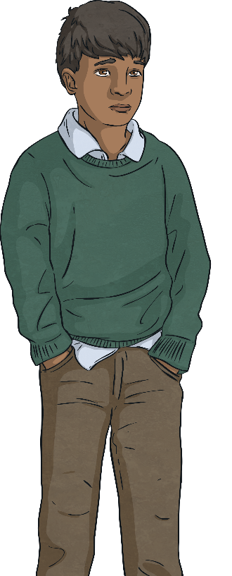
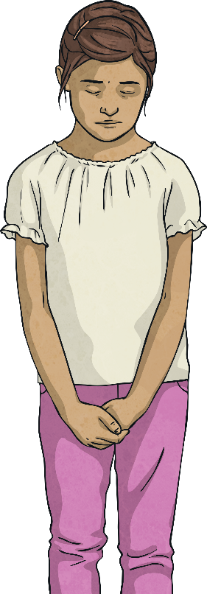

Staying Safe and Healthy
It can be difficult to speak up sometimes when we don't feel safe or someone has made us feel uncomfortable. Being brave enough to speak up takes a lot of courage, but it's really important that we do, so that someone can help.
0
8
0
0
1
1
1
1
Some children phone Childline on 0800 1111 when they need to talk about something that has happened. When children call this number a person answers whom they can trust. They will then get the support and advice to report or deal with whatever has happened.
1
2
3
4
5
6
7
8
9
#
0
*

Slide 18
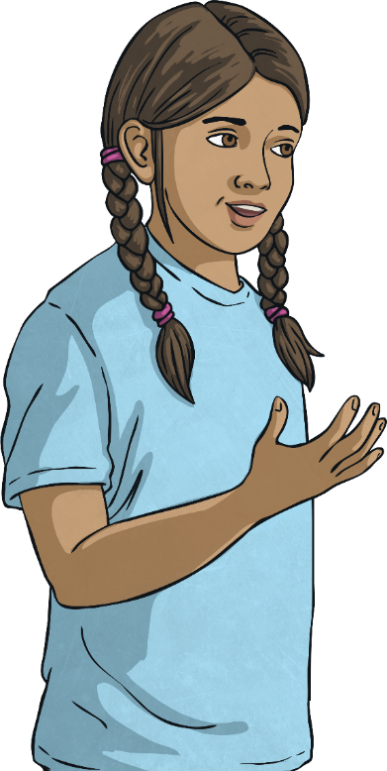
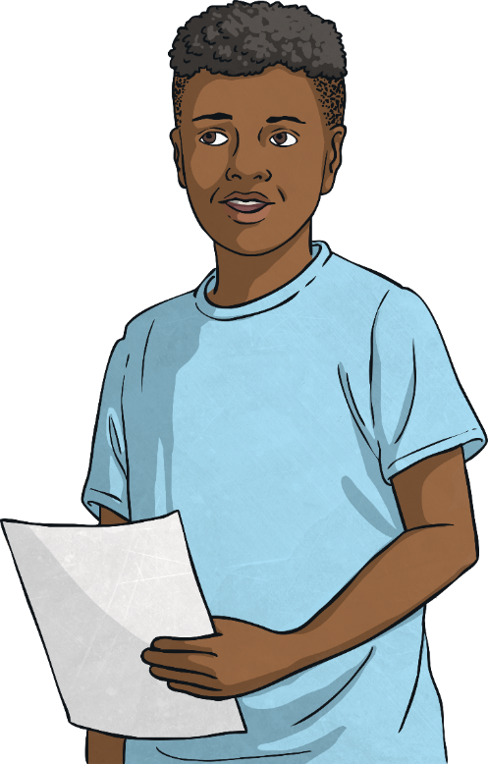
Let’s Talk about Sex
Consolidating
Reflecting

Slide 19
Consolidating

Slide 20
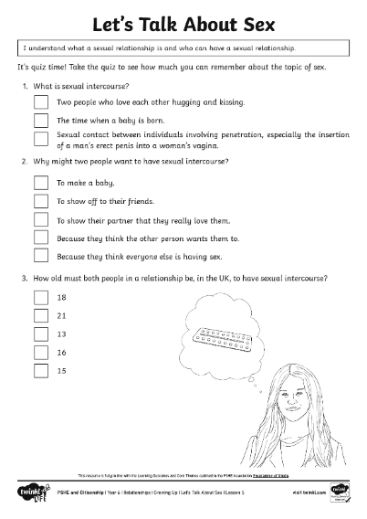
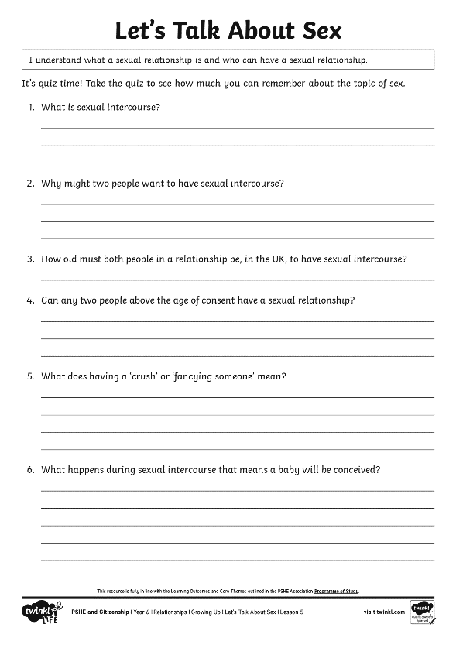
Giving Advice
It’s time to get thinking about what you have learnt about sex!
Think carefully about the questions on your quiz sheet.
Try to answer using the
correct scientific vocabulary used in the lesson.

Slide 21
Reflecting

Slide 22

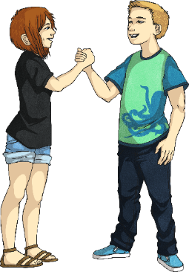

Questions and Answers
With your partner, look back at your questions from the start of the lesson.
Together, decide whether these questions have been answered in today’s lesson.
Perhaps you are able to answer your partner’s question for them.
If you still have questions you would like answered, put them in the question box at the end of the lesson and we can come back to these another time.
With your partner, write down three things that you have learnt today.

Slide 23
The Big Questions

Slide 24
The Big Questions
What is a sexual relationship and who can have one?
What is an STI and how can they be prevented?
What type of physical contact is unacceptable and how should we respond?

Slide 25
Aim
I understand what a sexual relationship is and who can have a
sexual relationship.
Success Criteria
I can describe the terms ‘sexual relationship’ and ‘sexual intercourse’.
I can explain who can have a sexual relationship, according to
the law.
I can explain what an STI is and I know how these can be prevented.
I can judge when physical contact is unacceptable and I know how
to respond.

